Slide 1

Note: The data and information in this document is reflective of a hypothetical situation and client. This document is to be used for KPMG Virtual Internship purposes only.
Sprocket Central Pty Ltd
Data analytics approach
Created by Tram Nguyen

Slide 2
Note: The data and information in this document is reflective of a hypothetical situation and client. This document is to be used for KPMG Virtual Internship purposes only.
Agenda
1. What are the trends in the underlying data?
2. Which customer segment has the highest customer value?
3. What do you propose should be Sprocket Central Pty Ltd ’s marketing and growth strategy?
4. What additional external datasets may be useful to obtain greater insights into customer preferences and propensity to purchase the products?
Specifically, it is important to specify who Sprocket Central Pty Ltd’s marketing team should be targeting out of the new 1000 customer list as well as the broader market segment to reach out to.

Slide 3
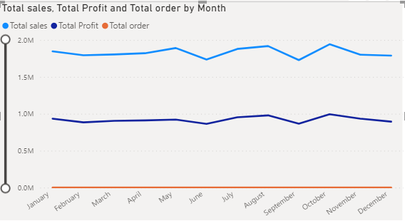
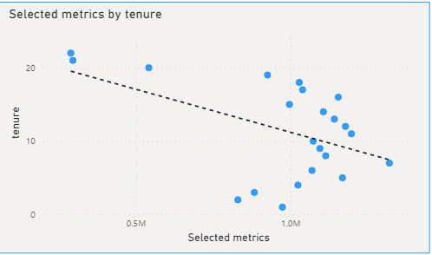
Note: The data and information in this document is reflective of a hypothetical situation and client. This document is to be used for KPMG Virtual Internship purposes only.
What are the trends in the underlying data?
General trend: total revenue, total profit and total order seem stable through out the year 2017.
Revenue and profit drop in June and September explained by the cold weather in winter (May, June) and rainy season(December til March). High season falls into August and October when people enjoy cool weather.
For customers having tenure below 10 years, the longer the tenure, the more revenue/profit they are likely to generate.
For customers having tenure between 10 and 20 years, the longer tenure they have, the less revenue/profit they are likely to generate.

Slide 4
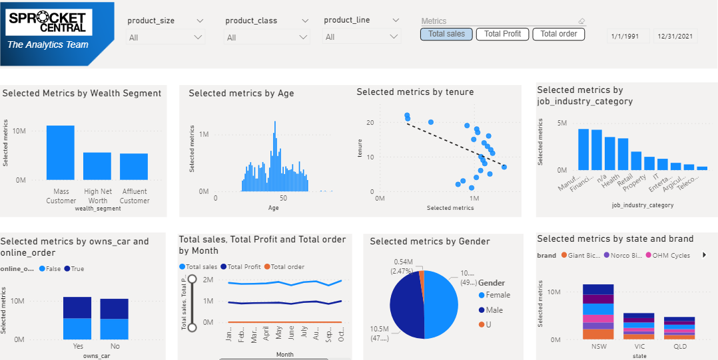
Note: The data and information in this document is reflective of a hypothetical situation and client. This document is to be used for KPMG Virtual Internship purposes only.
Which customer segment has the highest customer value?
Links
Demographics metrics:
Age: 20-70 focus group: 40-50 (highest frequency)
Wealth segment: Mass customer occupies the largest proportion of sales and profit of 10 million and 5.5 million.
Gender: almost the same distribution between male and female customers.
Job industry: Customer working in manufacturing, financial service and health sector generate the highest sales and profit (75%),
Car ownership: 50% of customer owning car.
Geographics metrics:
Sales distribution to regions are NSW (53%), Victoria(25%), Queensland(21%) corresponding to the specific weather of each region. QLD is hot and humid however they have dry summer and warm winter. NSW weather is characterized by hot dry summer but cold winter. VIC has temperate and cool temperature and cold winter.

Slide 5
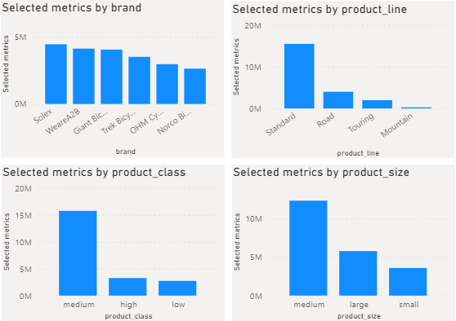
Which customer segment has the highest customer value?
Note: The data and information in this document is reflective of a hypothetical situation and client. This document is to be used for KPMG Virtual Internship purposes only.
Psychology metrics:
Customers prefer buying products belonging to normal brands Solex, WeareA2B, Giant Bicycle. It is understandable that best seller items having attributes like standard product line, medium product class and medium product size.
Other special purposed lines hobbies such as Road, Touring and Mountain are tailored to a number of smaller groups of customer.
Customers pays less attention to luxury status of the bike (product_class).
Behaviour metrics:
There is a balance distribution between online and offline channels.
The last 3 years purchase history does not reflect any implication to the future buying behavior(no correlation detected)

Slide 6
What do you propose should be Sprocket Central Pty Ltd ’s marketing and growth strategy?
Note: The data and information in this document is reflective of a hypothetical situation and client. This document is to be used for KPMG Virtual Internship purposes only.
Expand the key age group beyond range 40-50, focus on younger customers, especially below 20 and teenager groups.
Maintain and reinforce the target group of mass consumers and win more customers of wealthy segment by introduction of luxury/smart or new add-ins features bikes.
Running marketing campaigns focused on the health benefit and sustainable future of bicycle owning to the fact that there are more people not having cars as their main transportation vehicle. Bike could not only be a hobby tool or sport but also a means of transportation.
Queensland and Victoria’s sales could be improved by having more marketing and sales activities in these regions. Products should also be designed with specific features of tires that suit their topography.
Approach customers who are short to medium leasing tenants.
For the high value consumers, the strategy is to improve retention.
For the medium value consumers, the strategy is to improve retention and recency.
For the low value consumers, the strategy is to increase the frequency.

Slide 7
Note: The data and information in this document is reflective of a hypothetical situation and client. This document is to be used for KPMG Virtual Internship purposes only.
What additional external datasets may be useful to obtain greater insights into customer preferences and propensity to purchase the products?
When it comes to geographical local market in Australia, it is worth diving more into the climate condition, the topography of each state to have a better insights for new developments of product.
Additional datasets about the climate and geographical conditions in each region should be provided.
For better product developments, additional feedbacks/review on the products should be carried out to gain more customer information such as materials, designs, features, budget, and services.
It is also useful to have additional datasets from supplementary products in order to know which products are also bought when consumers buy our main products, therefore sales campaign could be carried out based on these findings.
It’s also interesting to know the product related psychology aspect, if customers belongs to a group or organization or they are individual buyers and using bikes alone.

Slide 8
Note: The data and information in this document is reflective of a hypothetical situation and client. This document is to be used for KPMG Virtual Internship purposes only.
Appendix

